Slide 1

Submitted by
Name: Nushrat Jaben Aurnima
ID: 2022-2-60-146
Name: Shairin Akter Hashi
ID: 2022-2-60-102
Name: MD Shahrukh Hossain Shihab
ID: 2022-1-60-372
Name: Zihad Khan
ID: 2022-2-60-107
East West University
Semester: Summer 2025
CSE495, Section:1
Project title: LagbeNaki? Help Ashche Click-e
Submitted to
Sadika Islam Sneha Lecturer,
Department of Computer Science and Engineering

Slide 2

What is LagbeNaki?
Managing modern households can be overwhelming with chores like cooking, cleaning, laundry, and moving. LagbeNaki? offers a structured, reliable house help Assistance platform, unlike traditional inconsistent services. It provides flexible options—one-time, weekly, or regular help—allowing users to schedule and subscribe easily, ensuring organized, stress-free daily living and better work-life balance.

Slide 3





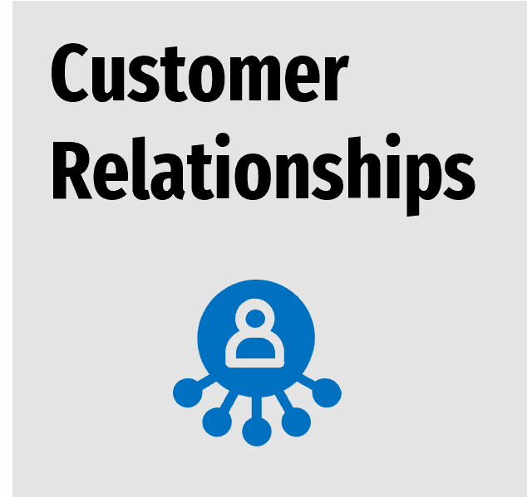



Business Model Canvas

Slide 4
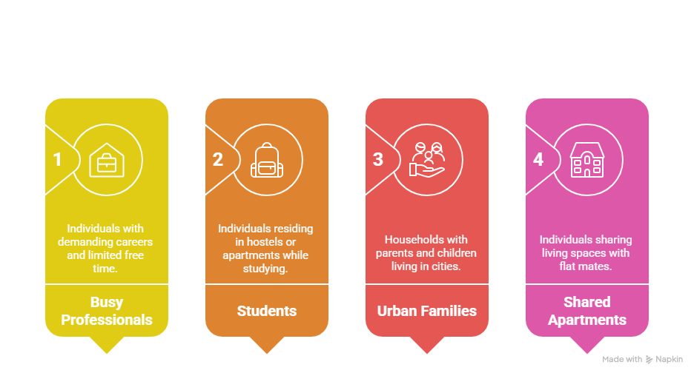
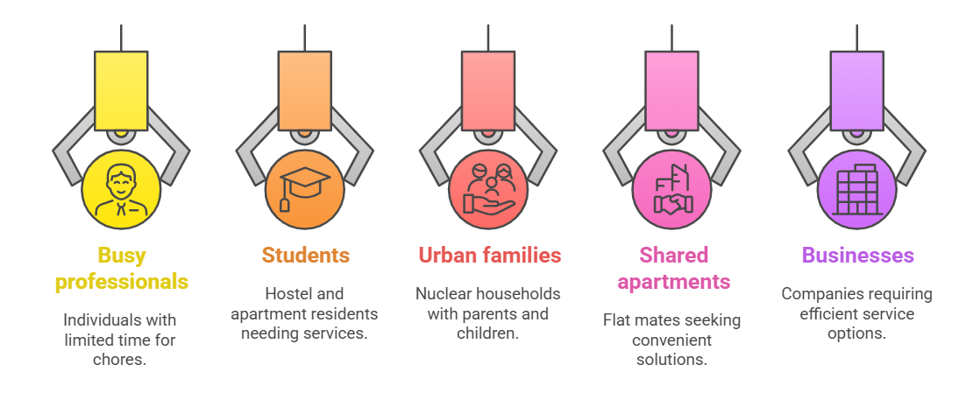
Customer Segments

Slide 5
Value Propositions
On-demand or scheduled household help (cleaning, cooking, laundry, errands, moving).
Flexible: choose tasks, time, and frequency.
Secure online payments, no cash hassle.
Loyalty points redeemable for discounts.
Verified, rated helpers for trust and transparency.
Fair pay and dignity for providers.

Slide 6
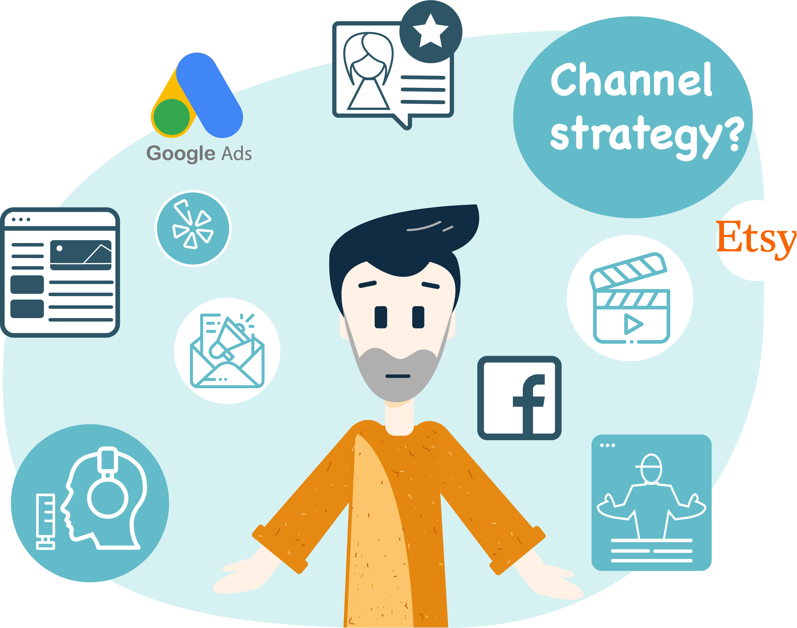
Channels
● Website.
● Social media
● Referral system.
LagbeNaki

Slide 7
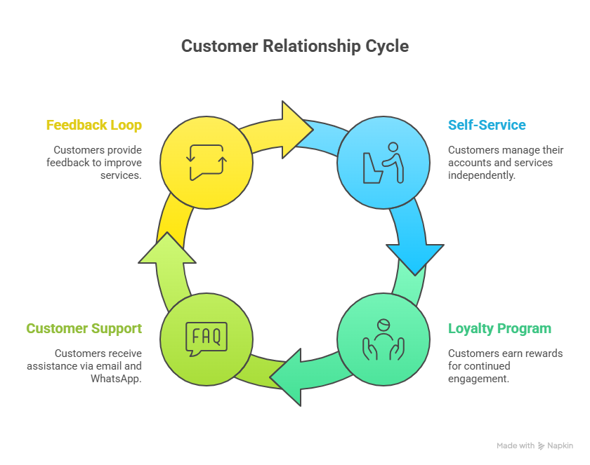
Customer Relationships
• Self-service via website (book, pay, review).
• Loyalty & rewards program.
• Customer support (Email + WhatsApp).
• Transparent review/feedback loop.

Slide 8
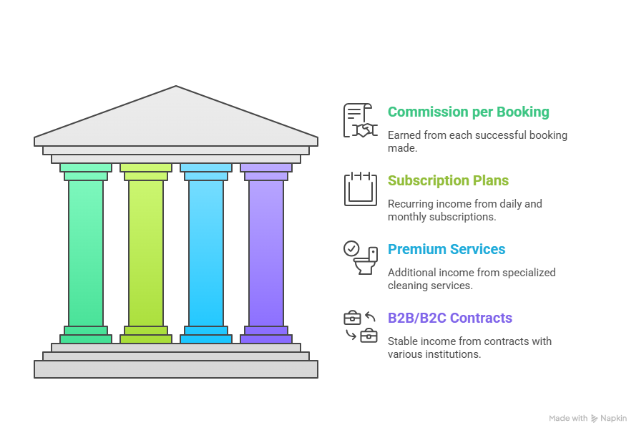
Revenue Streams

Slide 9
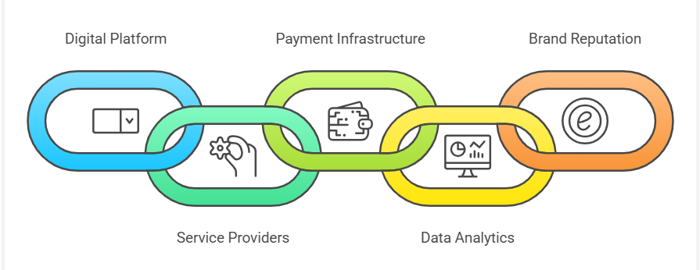
Key Resources

Slide 10
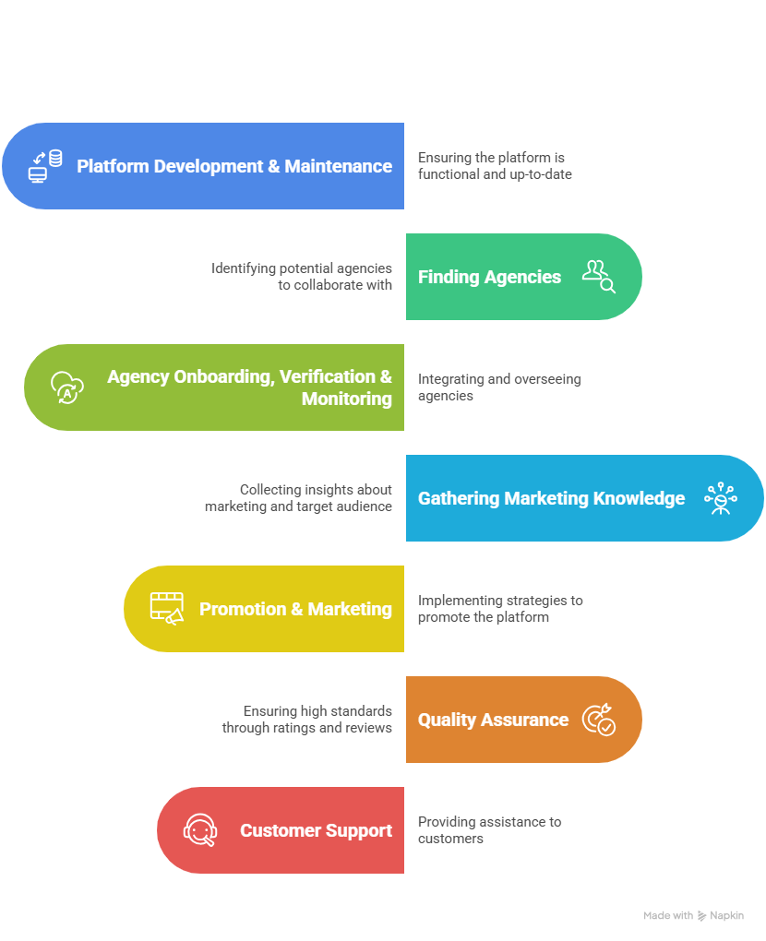
Key Activities
• Platform development & maintenance.
• Finding agencies.
• Agency onboarding, verification and monitoring.
• Gathering knowledge about marketing & target audience. • Promotion & marketing.
• Quality assurance (ratings, reviews, dispute resolution).
• Customer support.

Slide 11

Key Partners
● House help providers (agencies).
● Payment gateways (bKash, Nagad, cards).
● Cloud & tech infrastructure partners.
● Marketing partners (universities, local businesses, social media).
● Insurance/coverage partners (worker safety, liability).

Slide 12
Cost Structures
● Platform development & updates.
● Marketing, promotions, and customer acquisition.
●Agency onboarding & compliance
● Customer support operations
● Payment gateway transaction fees.

Slide 13

Growth Strategy

Slide 14
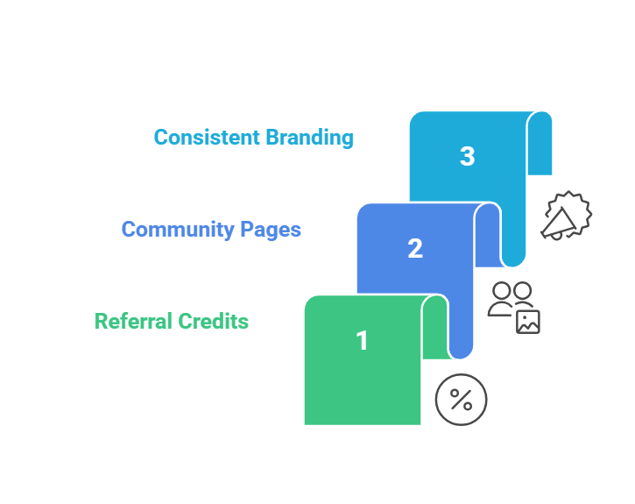
Market Penetration
•Using referral credits and quick reviewing systems after every
job.
•Building community pages (“Cleaning in Motijheel”) that feature
local photo
•Using same logo on all banners and posters for instant brand reminder.

Slide 15
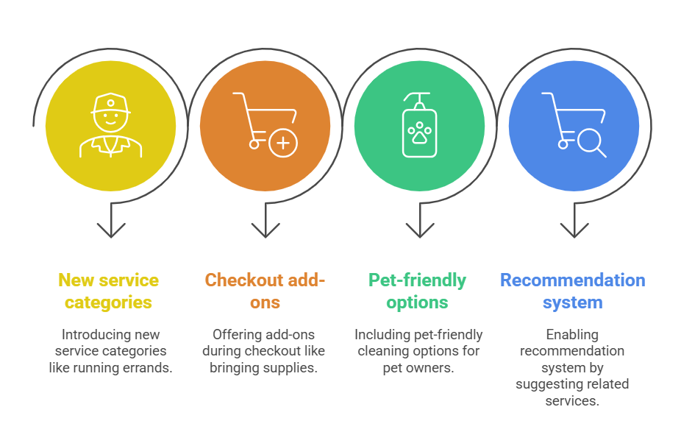
Product Development

Slide 16
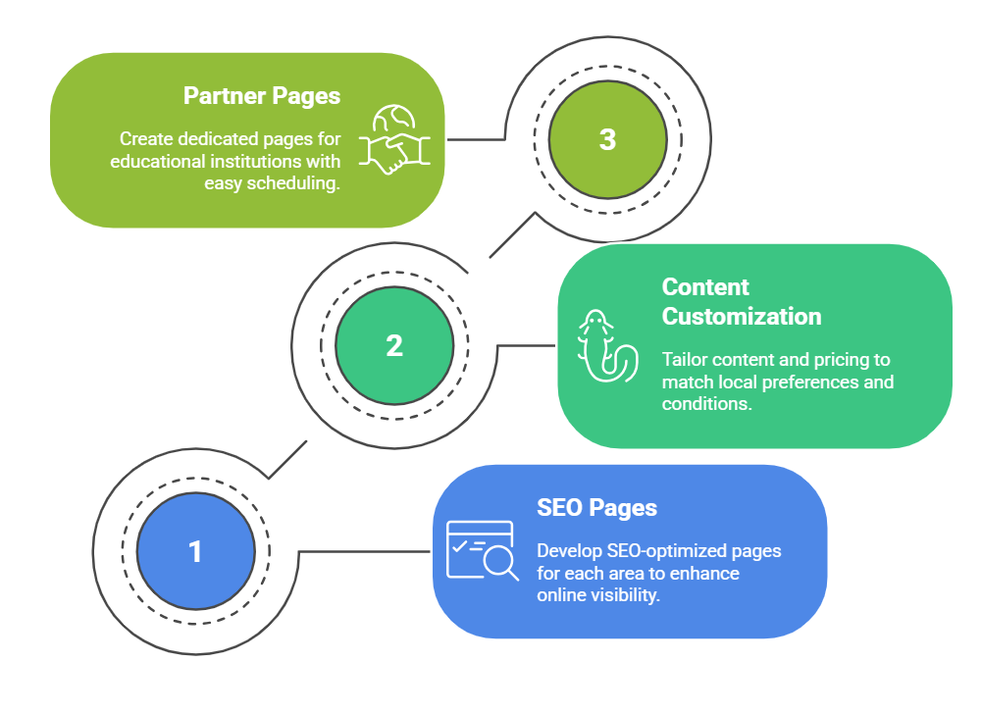
Market Development

Slide 17
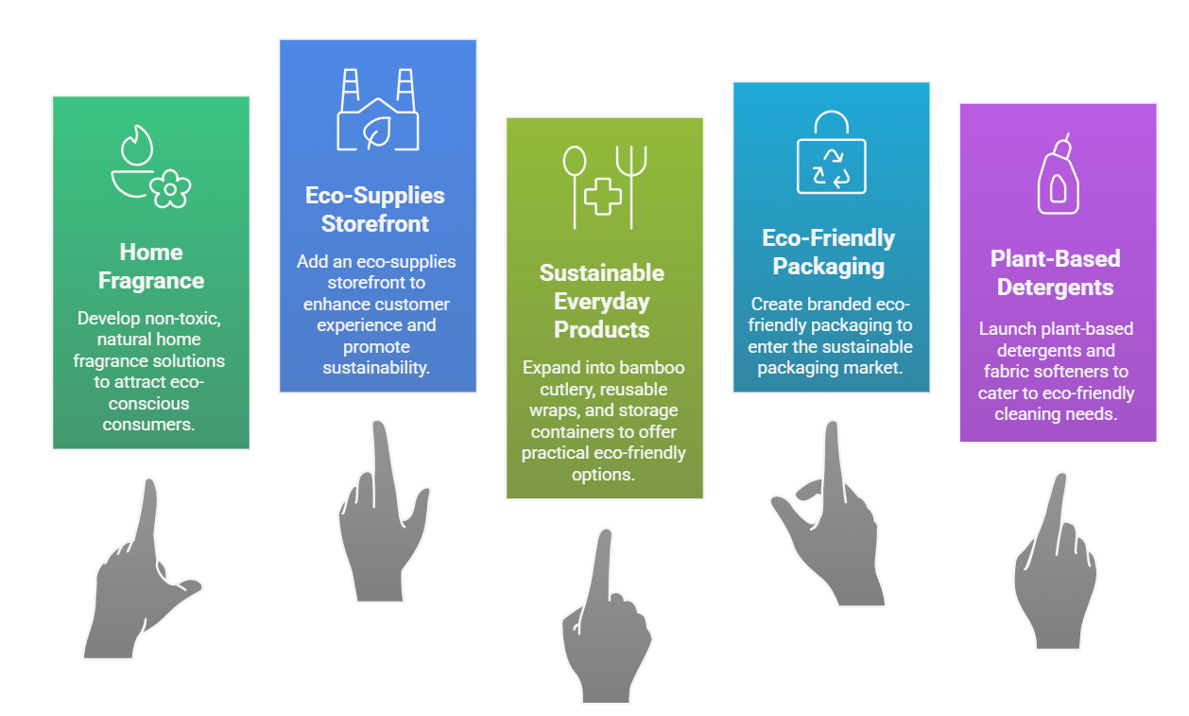
Diversification

Slide 18
Conclusion
LagbeNaki? presents a practical, technology-driven solution to modern household challenges by offering flexible, secure, and reliable domestic services. Through structured growth, Lean and Six Sigma practices, and data-driven KPIs, the platform ensures quality, scalability, and trust. It empowers users and providers, promoting convenience, sustainability, and work-life balance.

Slide 19
Thank you

